Slide 1
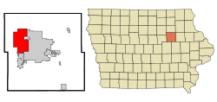
2018 Upper Mississippi River Conference
Cedar Falls, Iowa
Northeast Iowa
41,570 (Census 2017 estimate)
Black Hawk County population = 132,648

Slide 2
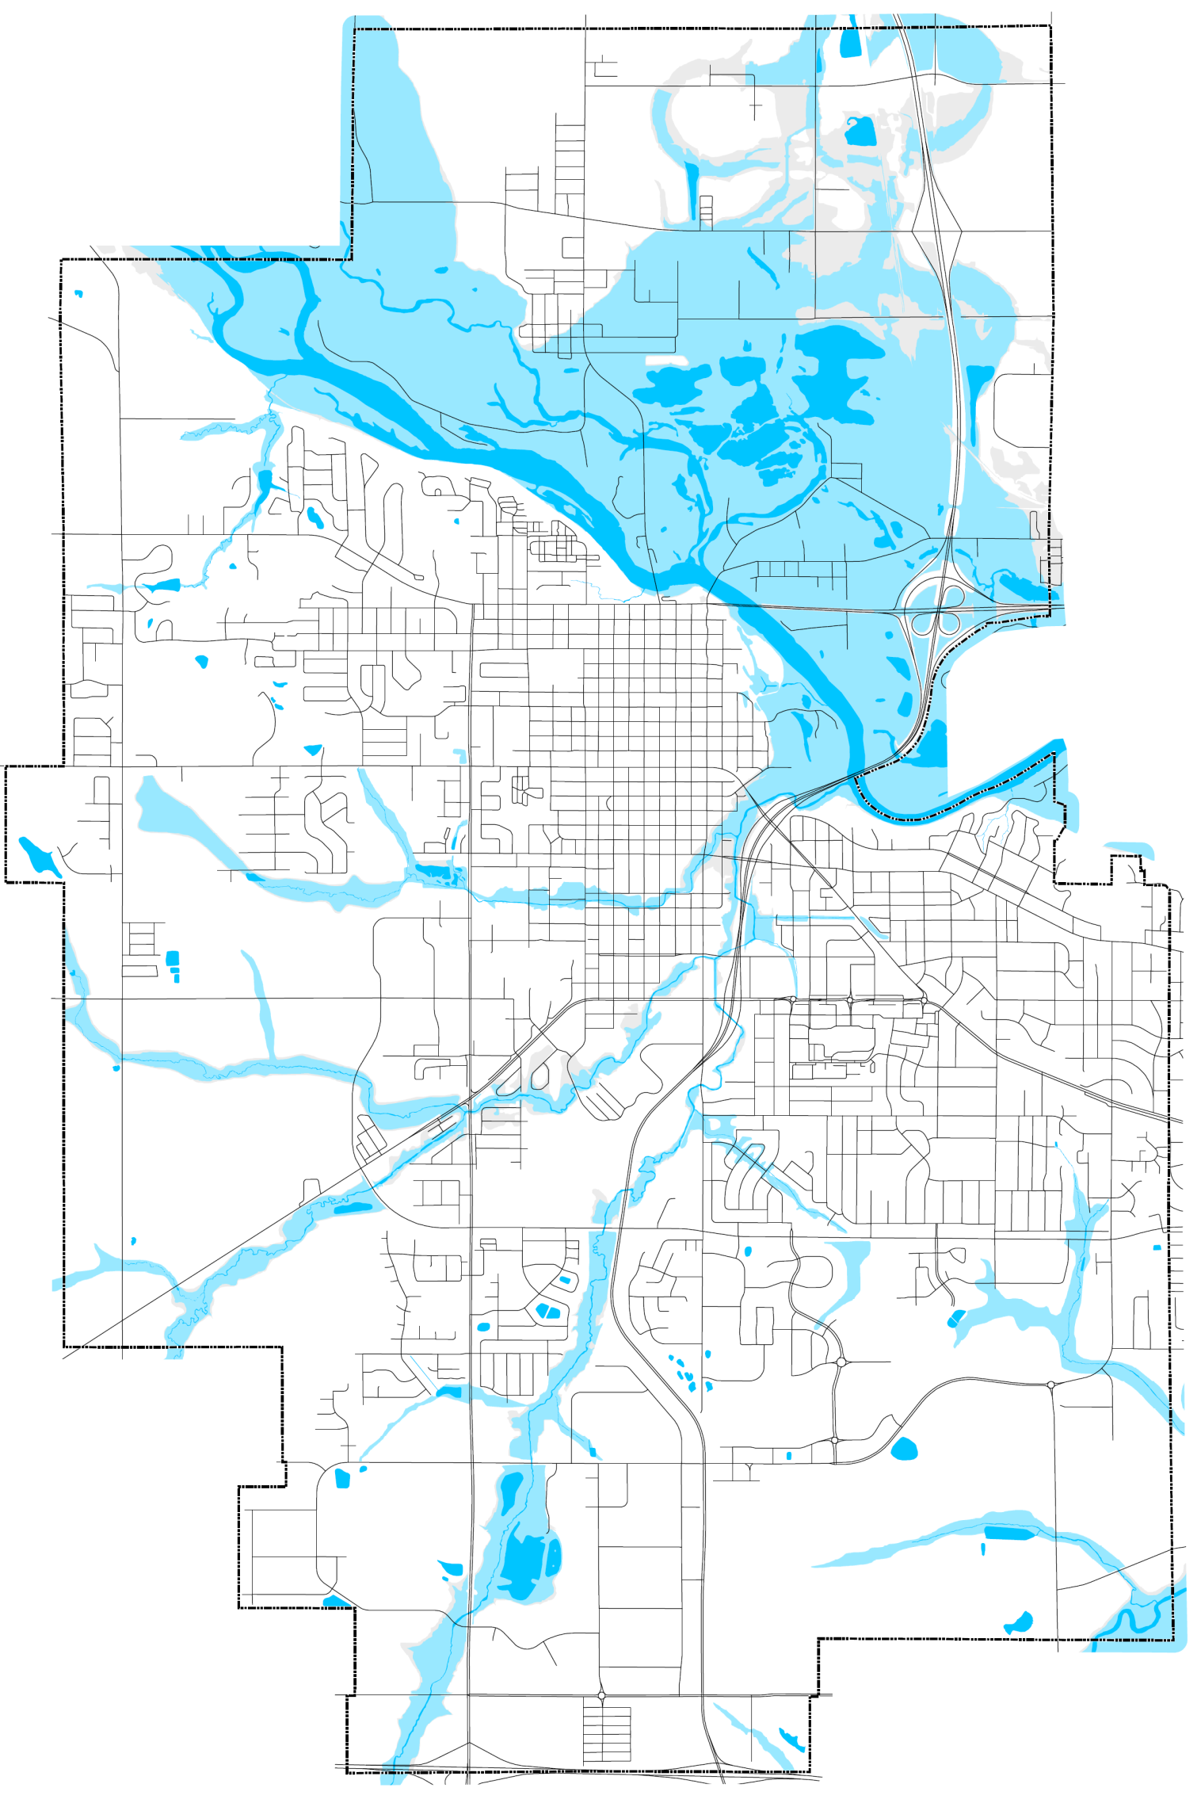
Floodplain Characteristics
Cedar River
4,100 acres in the SFHA
A and AE zones
Top 5 River Levels
2008 – 102.13
2016 – 98.9
1999 – 96.2
1961 – 96.1
1993 – 95.8
Top of the levee – 102.9
Project underway for 2 additional feet to top of levee
Notes:
Levee constructed in 2006-2007 @ 500 yr BFE
2 additional feet are currently being added to the levee
4600 acres including 500 year
18,500 acres in the city
Major stage @ 93.0’

Slide 3
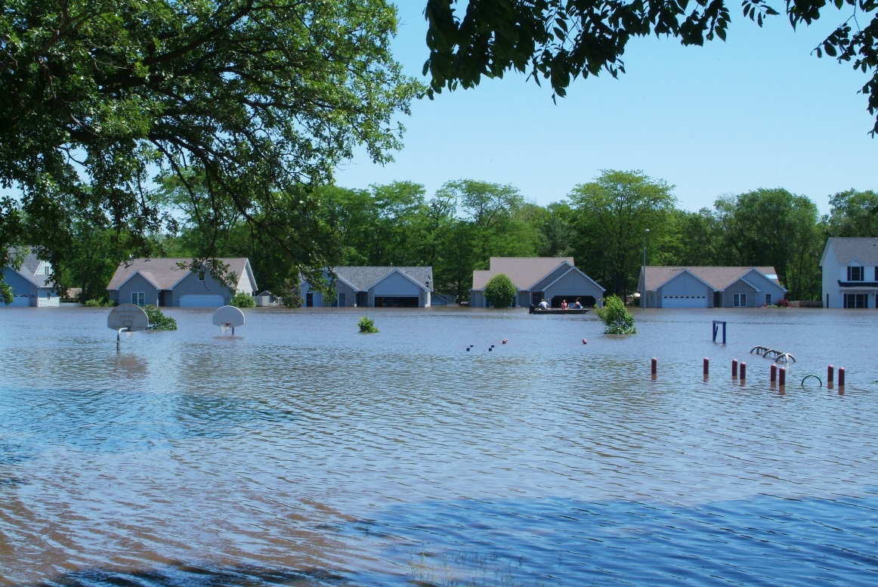
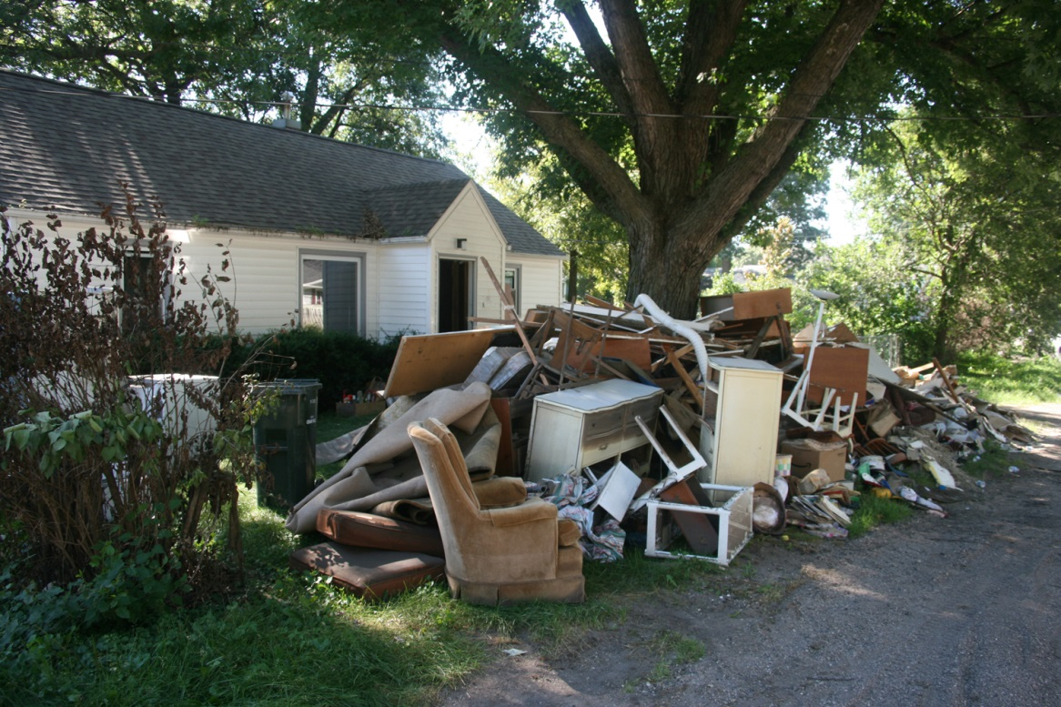
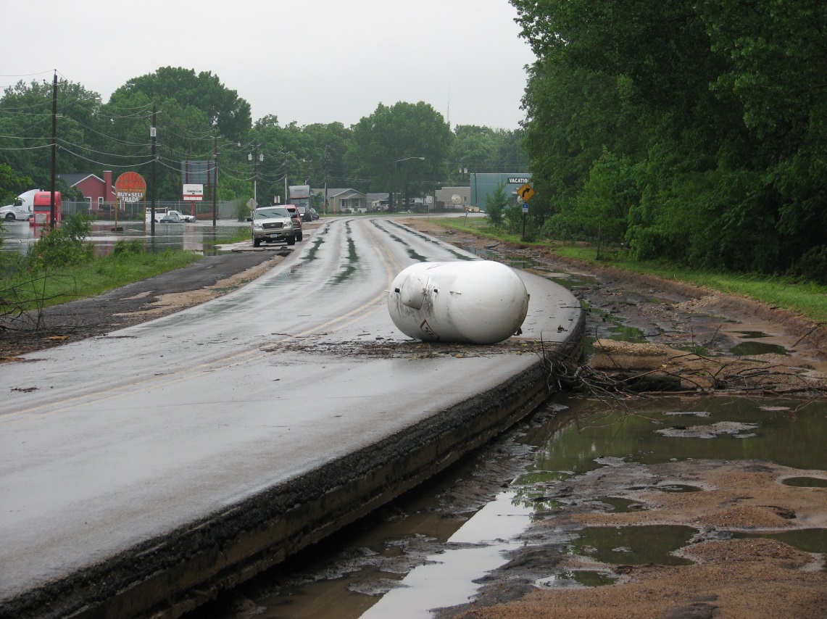
Flood Event Activities
PSAs
Set up Emergency Operations Center (EOC)
Departmental assignments
Fire Department Distributes Flood Information - Door to door
Donation drop off site
Maintain constant communication with the public and monitor flood elevations

Slide 4
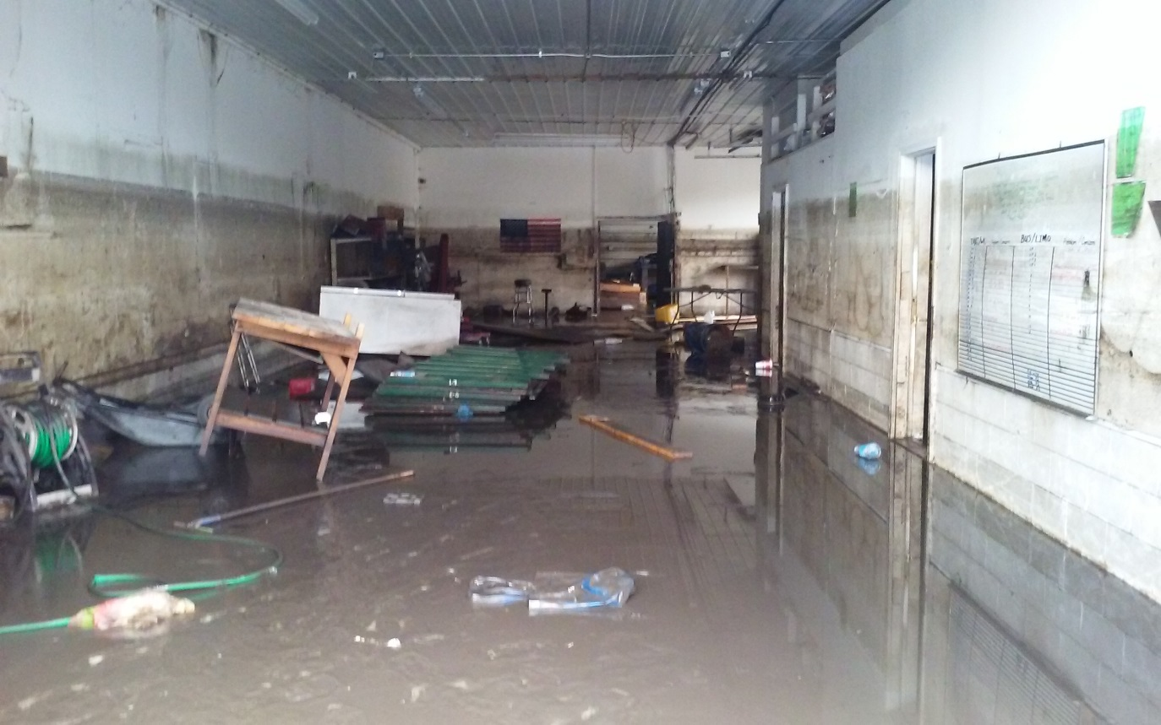
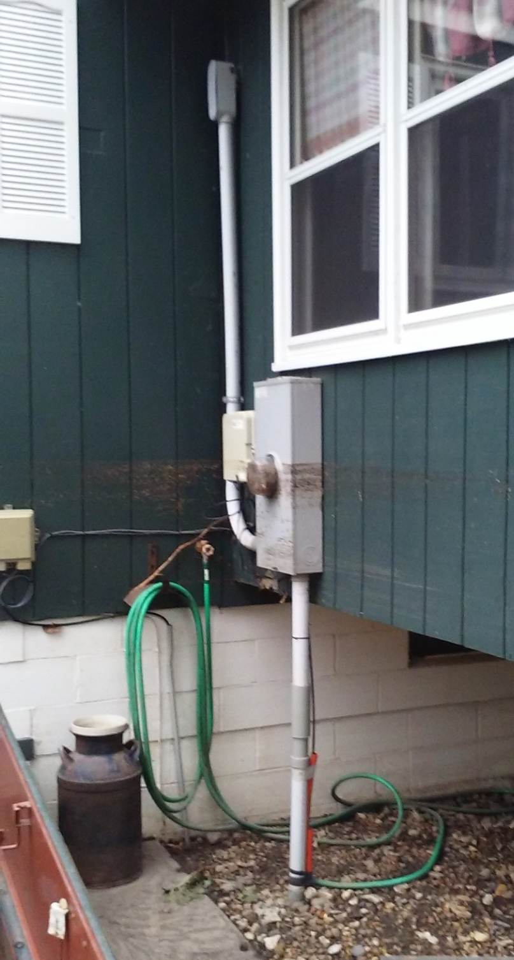
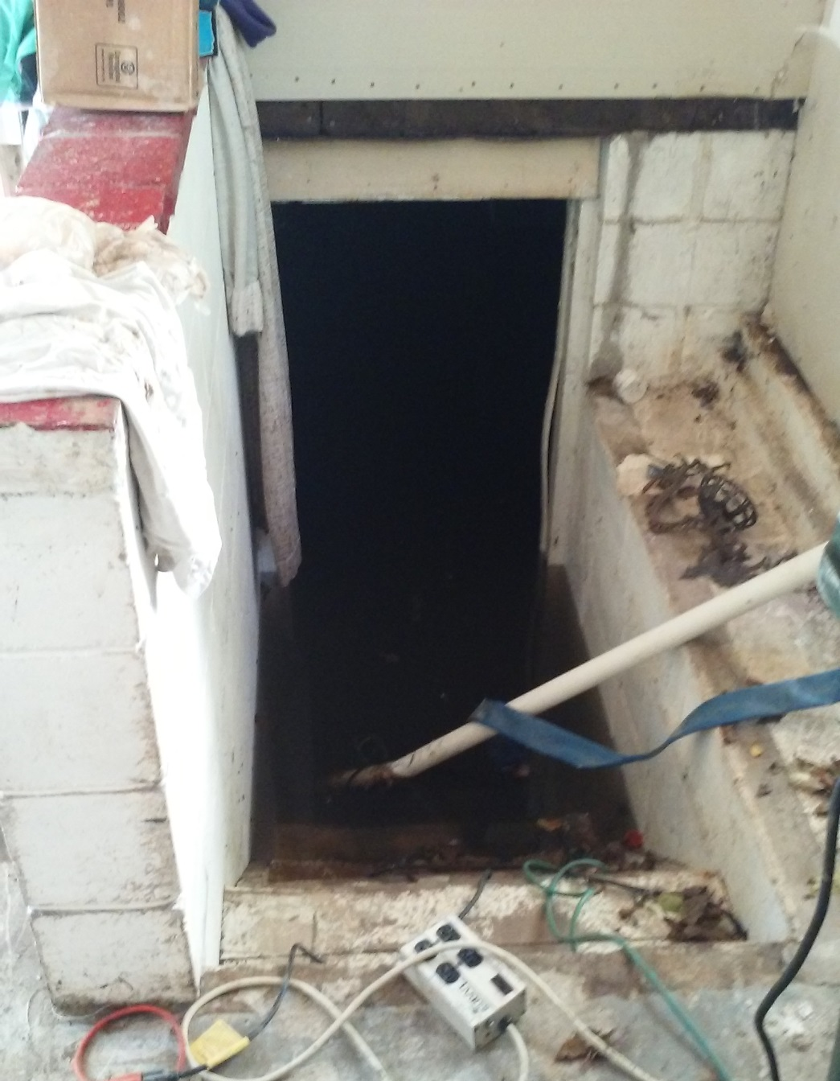
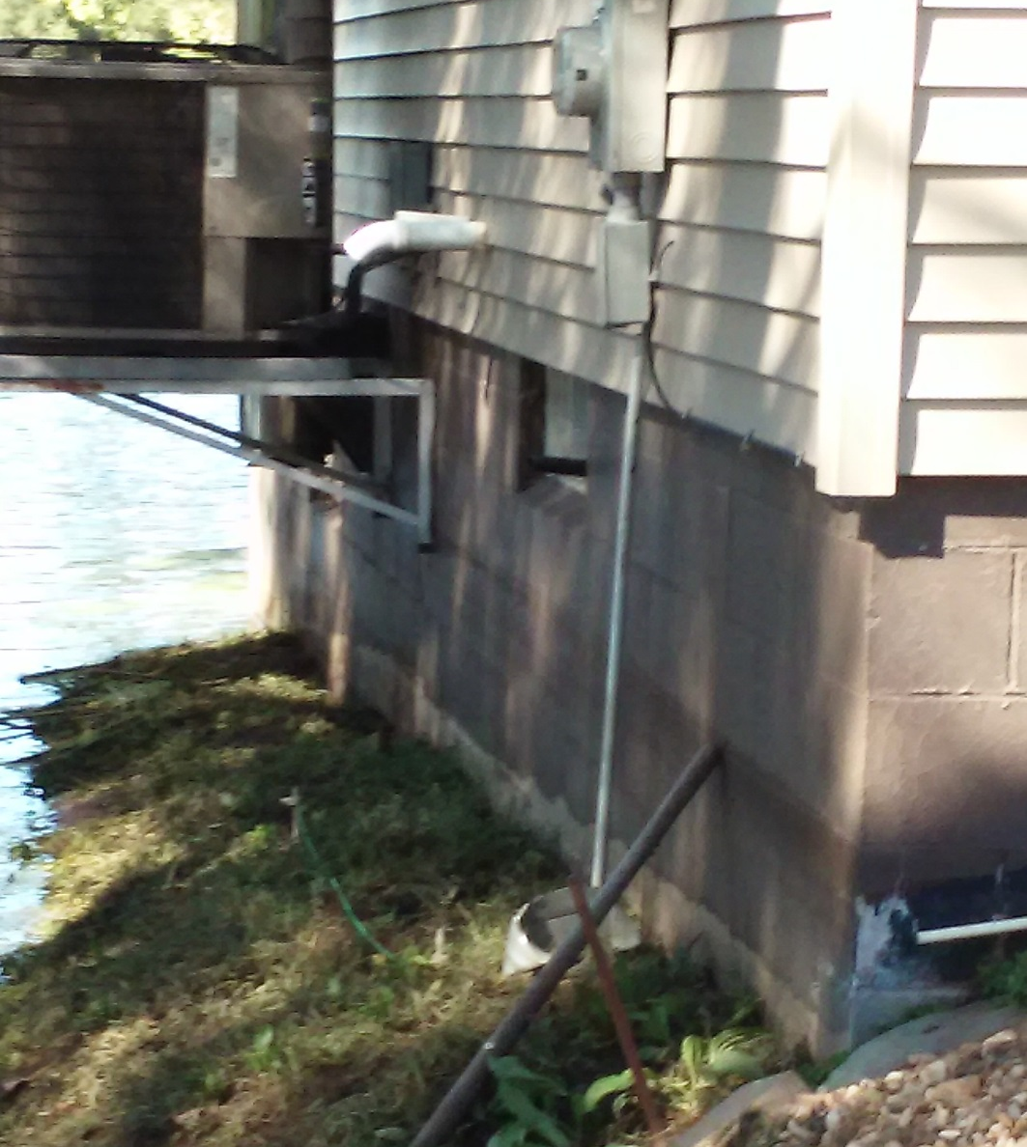
Post-Flood Activities
Property Inspections
Distribute post flood information
Damage assessments
Notes:
Post flood information = clean up, bulk pick up, Flood Insurance, ICC

Slide 5
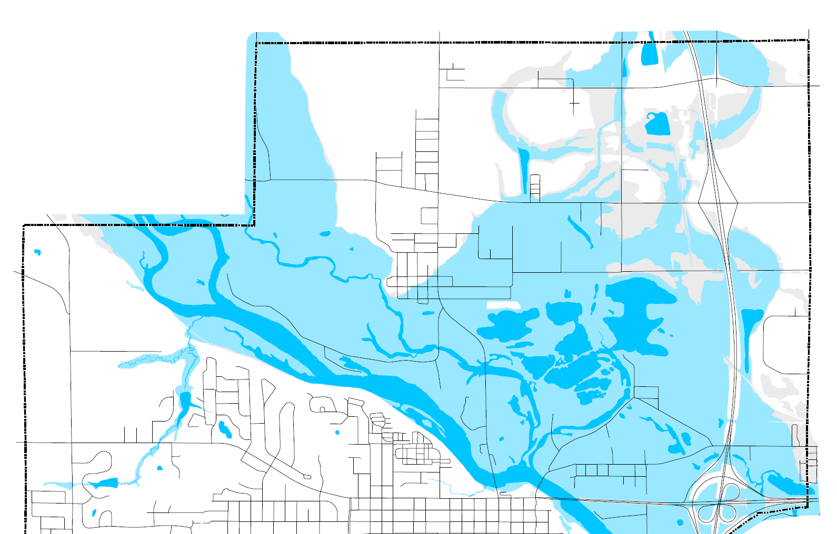
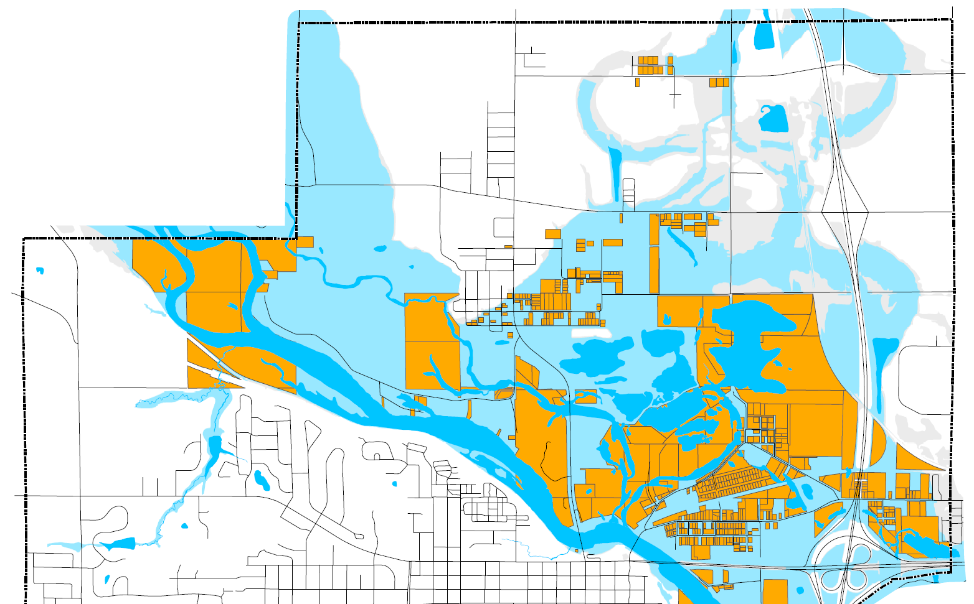
Cedar Falls Flood Buyout Program
1993 = 100 properties
1999 = 65 properties
2008 = 171 properties
2017 = 13 properties
Residential = 331
Vacant Lots = 5
Commercial = 11
Mobile Home Parks = 2
Total = 349
Notes:
1655 acres of open space

Slide 6
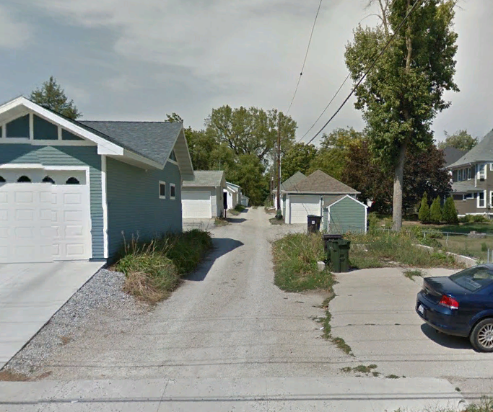
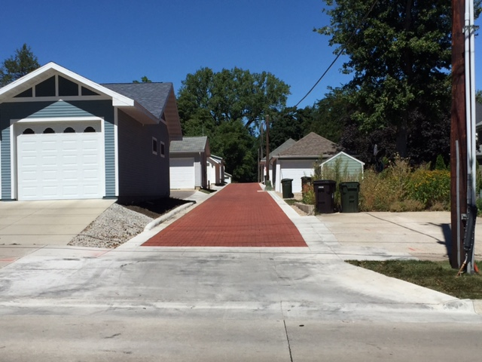
Ordinance Amendments
Lowest floor @ 500 year flood elevation + 1 foot
Limit fill activity in SFHA
3 foot maximum fill height
1/3 of the lot area
No LOMRs
Limit platting of lot in SFHA
Subdivision Ordinance (grading, stormwater detention)
Local Projects
Public Alleyway Projects
Permeable pavers
Stormwater control
Biocells installed as a part of the road project

Slide 7
Community Rating System
Cedar Falls CRS Community – May 2014, Recertified 2017
Class 5
Awarded points on certain activities
Maintaining flood maps, permits, elevation certificates
Public outreach
Open space preservation (buyouts)
Higher standards
Repetitive Loss Properties
Stormwater management
Floodplain management planning (Hazard Mitigation)

Slide 8
Thank You
David Sturch, Planner III
City of Cedar Falls, Iowa City of Cedar Falls
david.sturch@cedarfalls.com www.cedarfalls.com

Slide 9
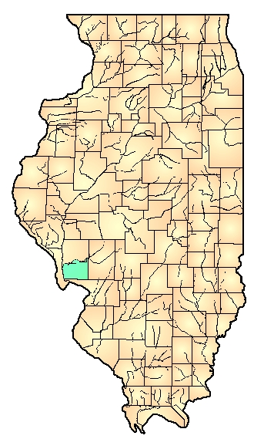
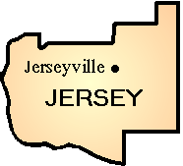
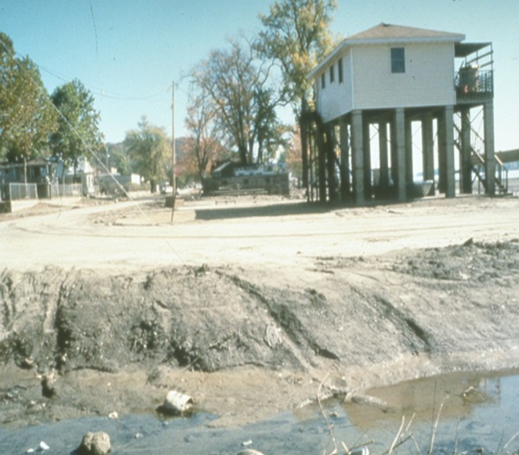
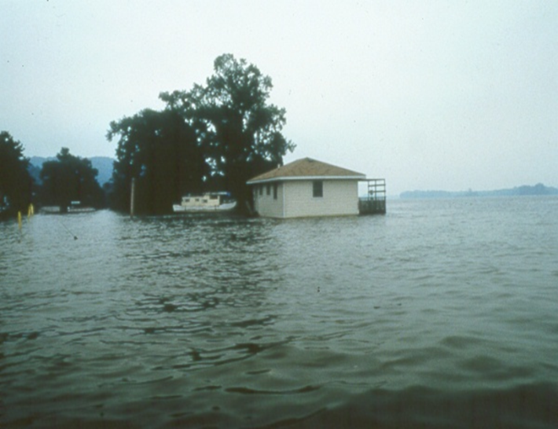
Jersey County at a Glance
12% of Jersey County mapped as floodplain (~29,000 acres!)
Confluence of the Mississippi and Illinois Rivers.
Missouri River confluence right across the river!
One them floods us every year!
If all three are flooding at once…we are screwed!
9 Federally declared disasters
Flood depths up to 25 feet!
1,599 claims for over $15 million (5.8 claims/building

Slide 10
Corps of Engineers Lease Cabins
Over 90% of our total flood insurance claims have been made on Corps lease property.
15 year struggle
1,500+ letters
Meetings with US Congressmen
Trips to DC
NBC Fleecing of America
US Army
Jersey County

Slide 11
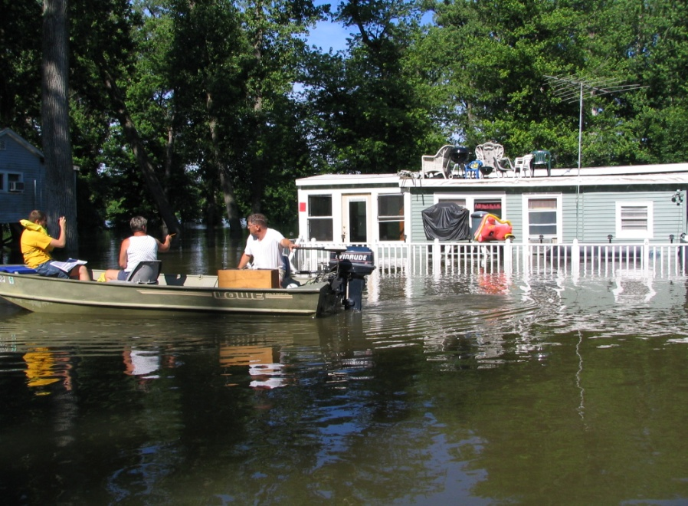
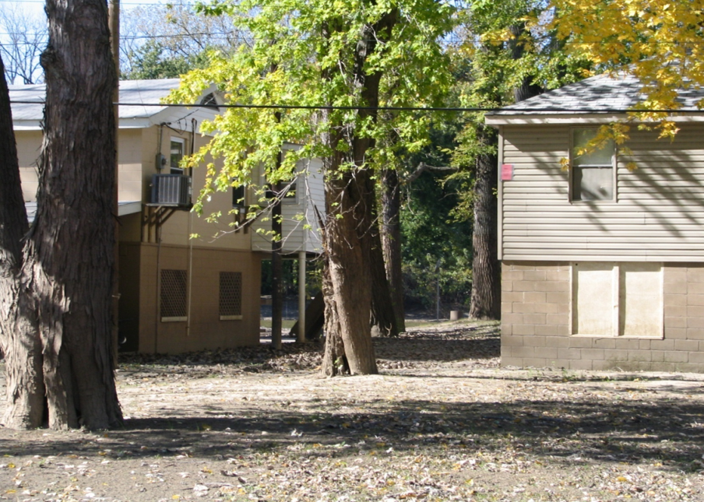
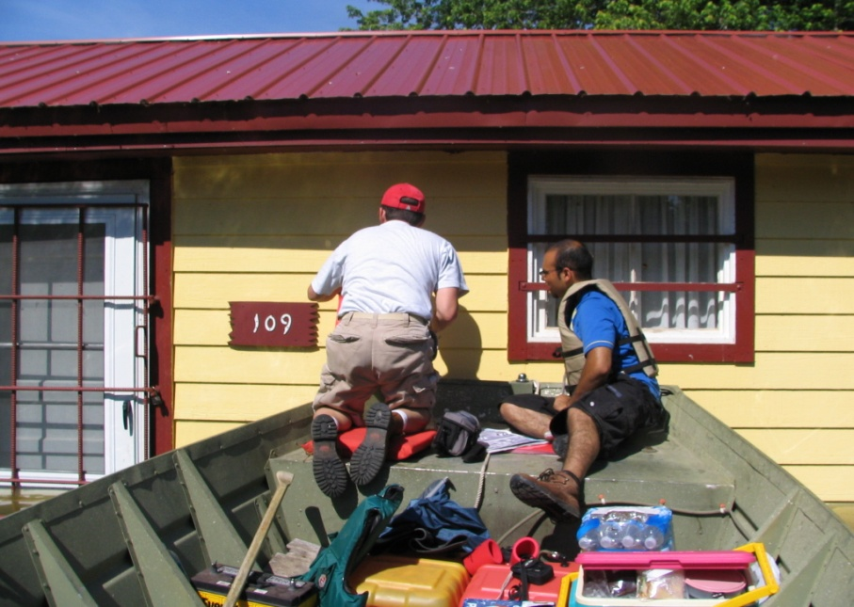
Strong Local Compliance Wins The Day
1995 Jersey County on NFIP Probation
2008 – Jersey County Class 5 CRS
Adopted Strong Regulations
Strict compliance
Cumulative Substantial Damage
Certified Floodplain Manager
2008 = 260 Rep Loss Structures
2018 = 23 Rep loss structures
KICK
ME

Slide 12
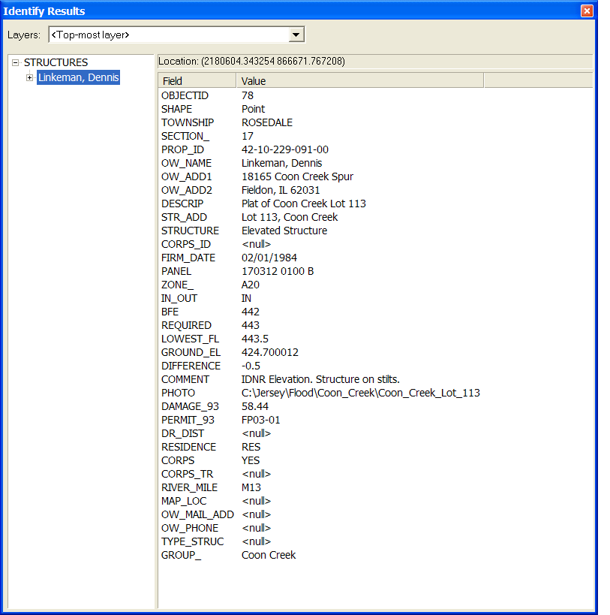
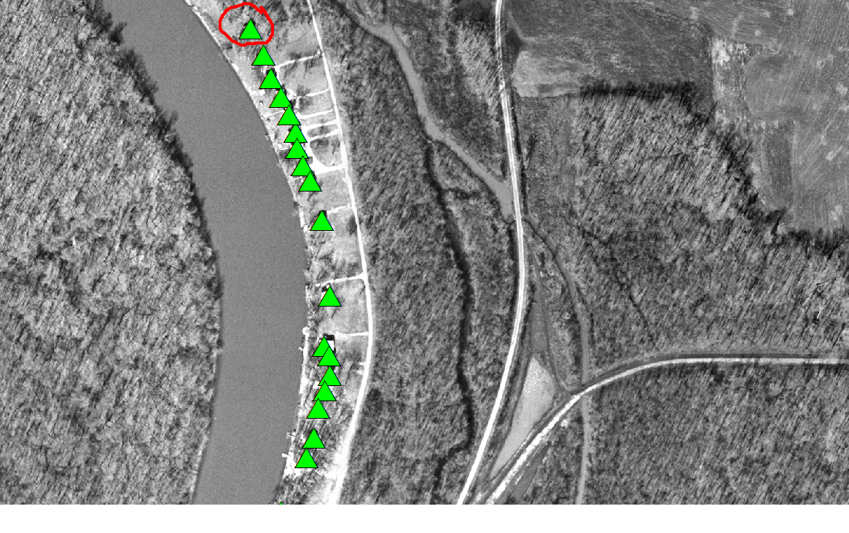
Got GIS? Track Permit Information!
Use of aerial maps and flood gages to identify flooded structures.
GIS database used for tracking information about structures

Slide 13
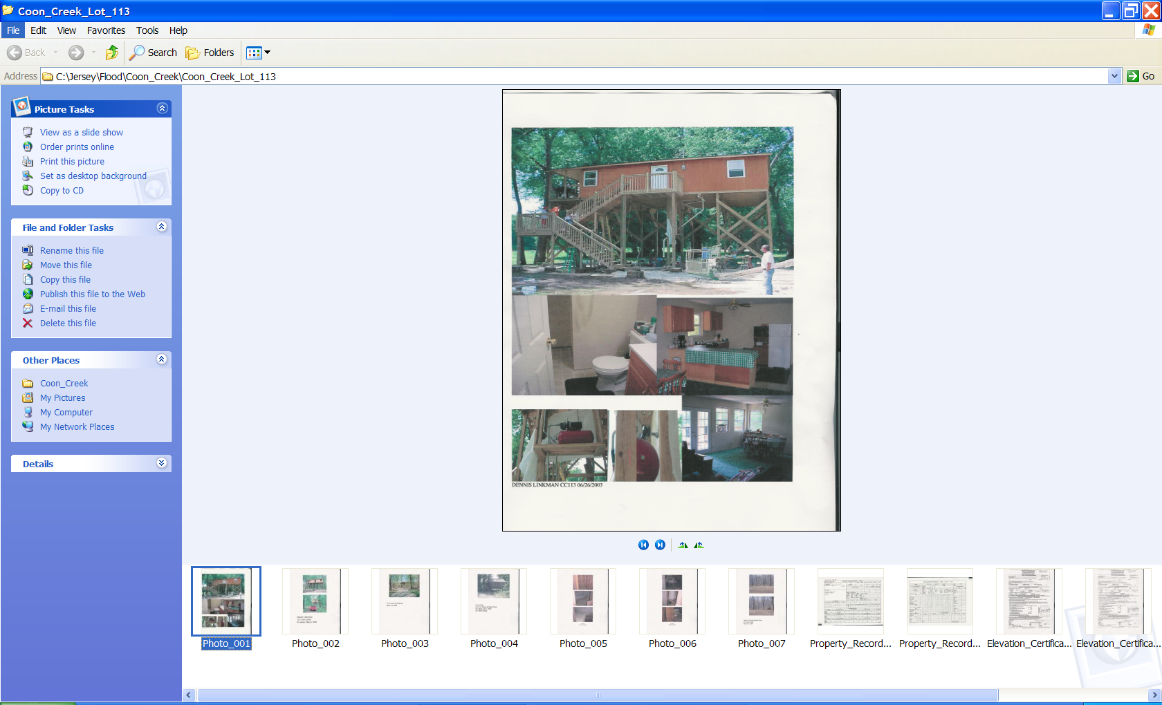
Floodplain Structures Info
Notes:
13
We also scanned all files and PICTURES into files and set up hyperlinks. This way we can pull up all the files we want in an electronic file.

Slide 14
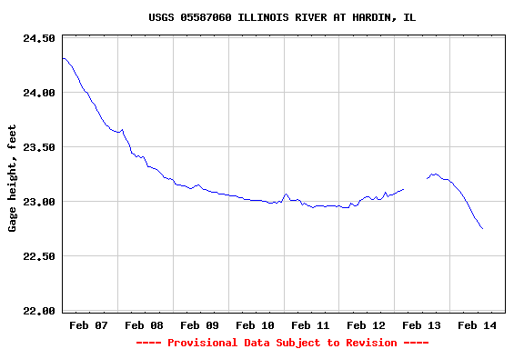
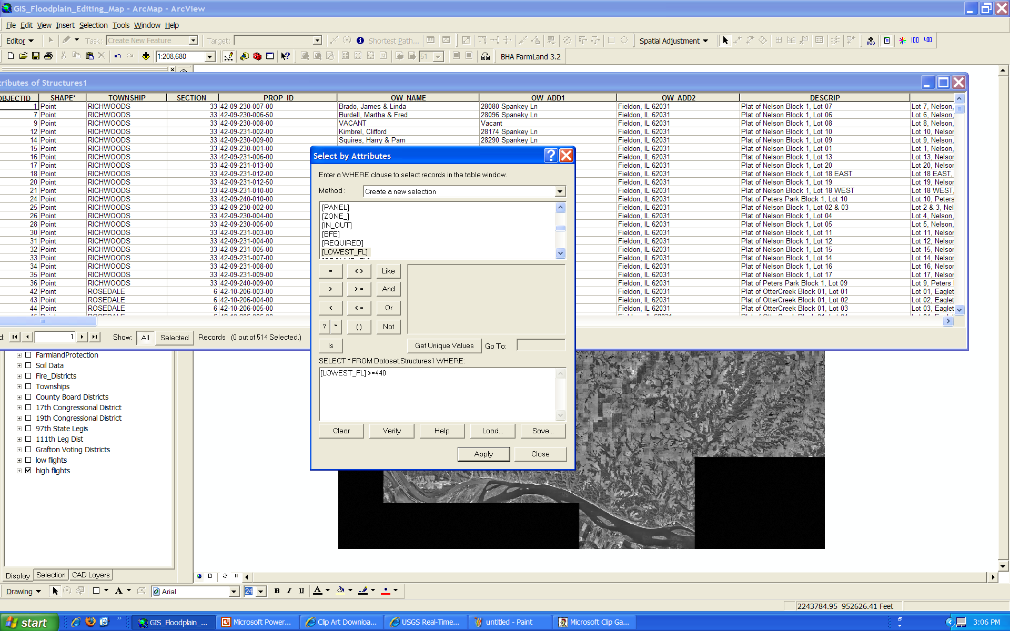
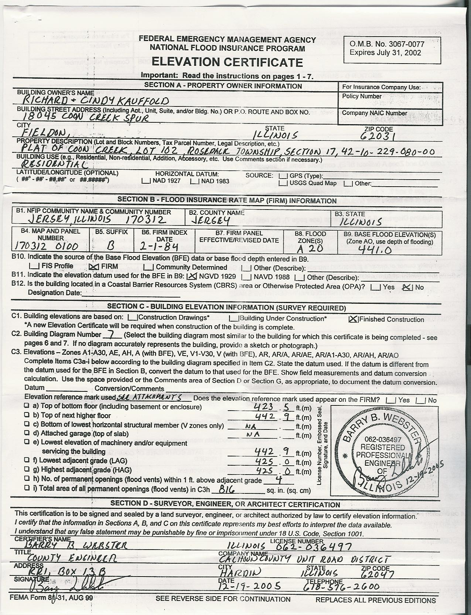
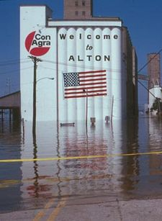
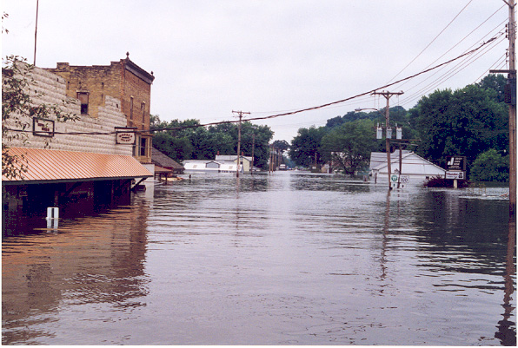
High Water Tracking
Notes:
14
Something new we have added and hope we don’t use very much is Flood and High Water Pictures. If we take a picture in this situation we put the approximate point of where it was taken and what was taken.
The data stored with this point is the date and comments – basically the conditions causing the high water or flood.

Slide 15
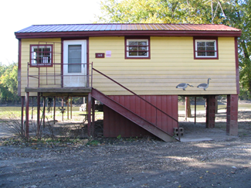
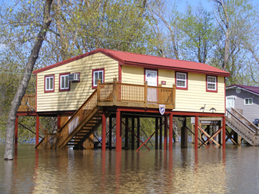
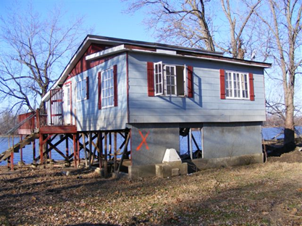
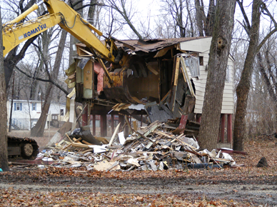
All 500(?) USACE Lease Cabins Now Demolished or Elevated

Slide 16
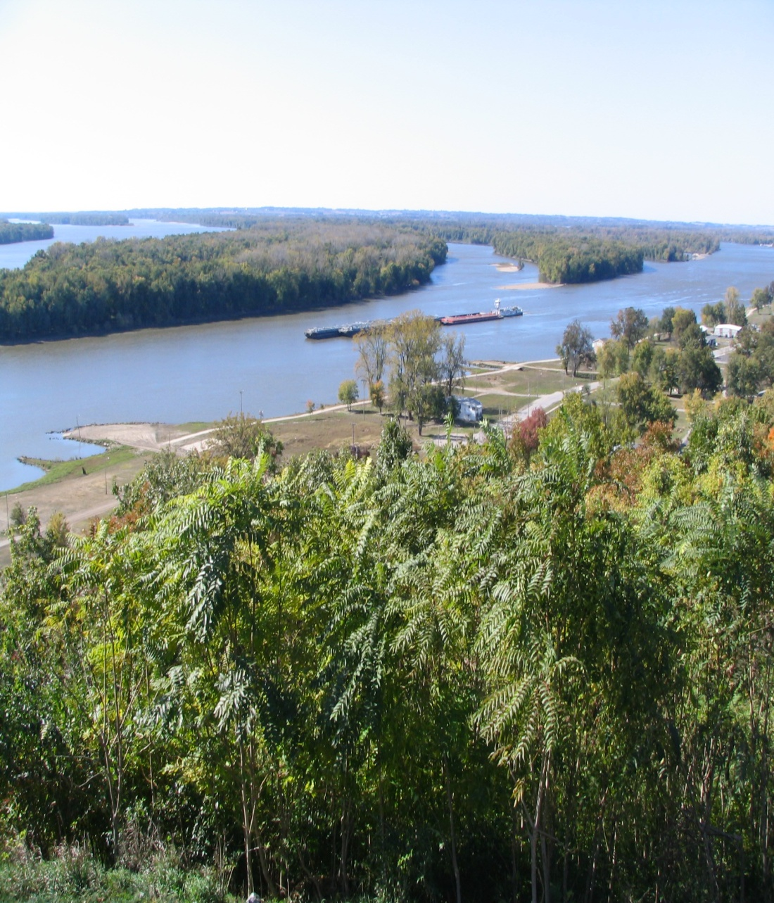
Flood? What Flood?
Cindy Cregmiles, CFM
Jersey County Code Administrator
codeadmin1@jerseycounty-il.us
618-498-5571 Ext. 146

Slide 17
Floods! Austin, Mn
Holly Wallace, Planning and Zoning
Credits:
Portions of this presentation were developed by Brad Woznak of SEH

Slide 18
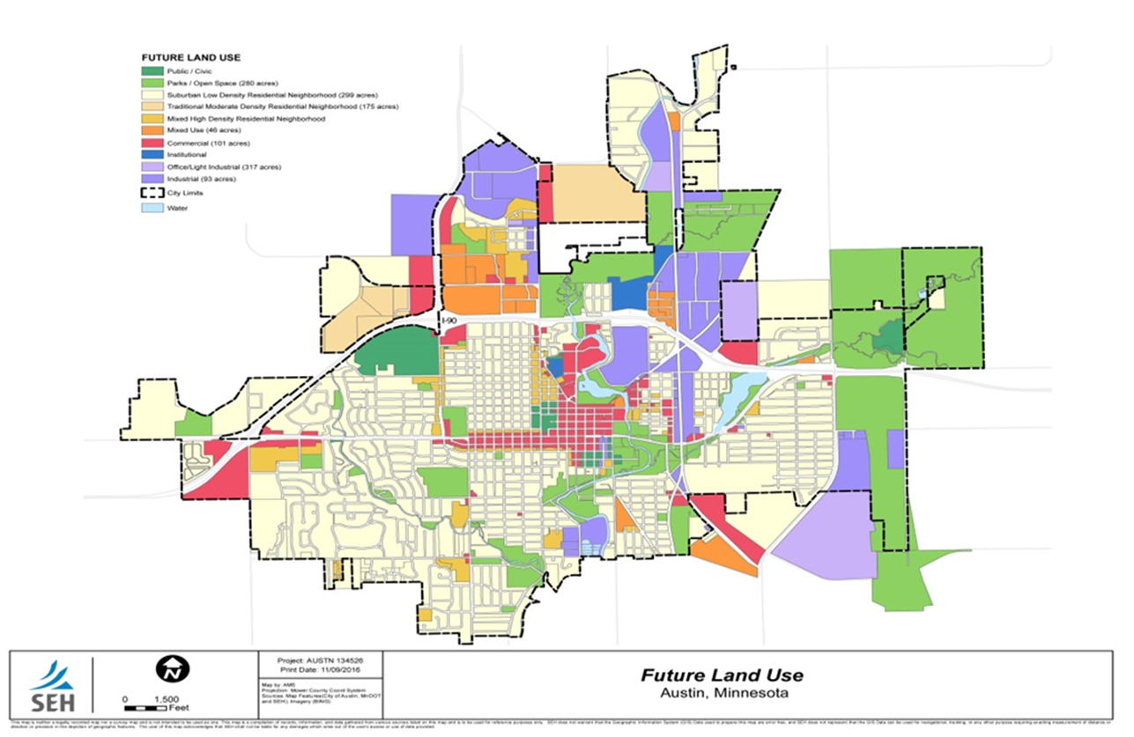

Slide 19
Background on Flooding Issues
Date of Flood Gauge Height(ft.) Max. Discharge(c.f.s)
1. September 15, 2004 25.0 20,000
2. July 10, 2000 23.4 15,500
3. June 12, 2008 22.4 14,800
4. July 17, 1978 21.9 12,400
5. August 15, 1993 21.3 10,800
6. September 24, 2010 20.6
7. September 23, 2016 19.8
8. July 2, 1983 18.2
9. July 7, 1978 18.1
10. March 26, 1950 17.8
11. May, June, July, 2000 17.4-17.6
12. March 29, 1962 17.2

Slide 20
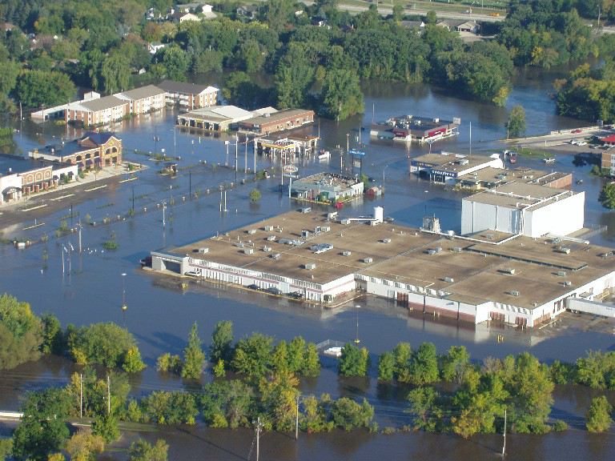
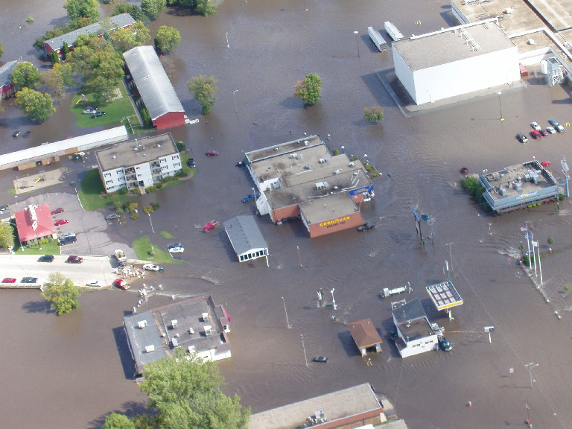
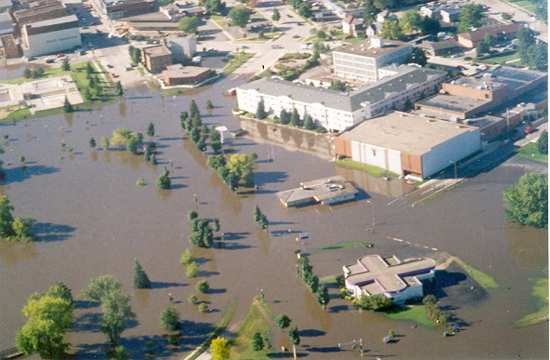
Recent Flooding History
Flood of Record – September 15, 2004
Estimated damages – $8 - $10 Million

Slide 21
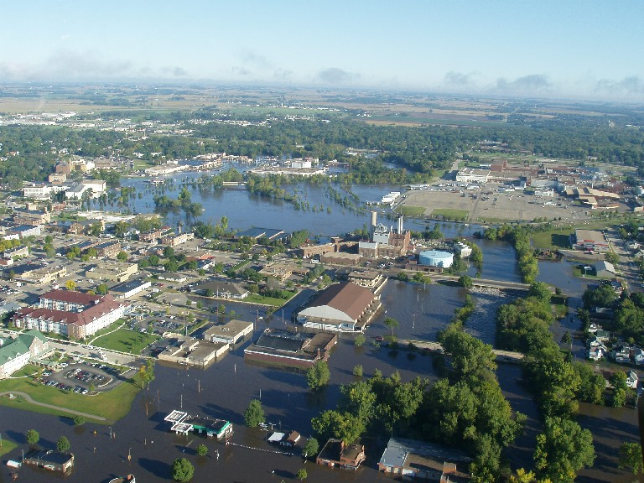
Flood of Record – September 15, 2004

Slide 22
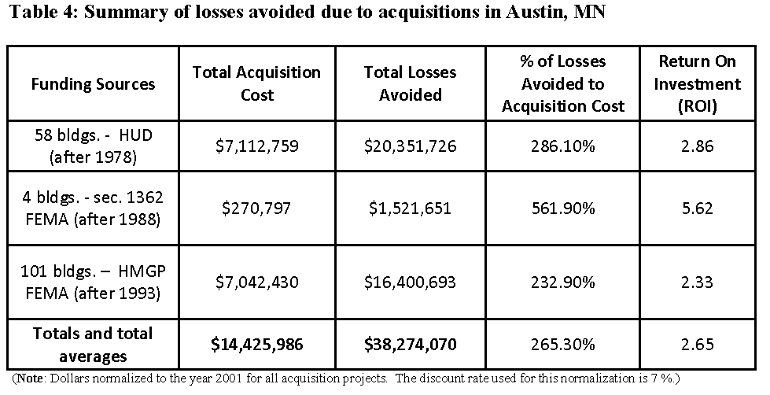
Results Highlighted in FEMA LAS Study
Notes:
1. 58 buy-outs after the 1978 floods have avoided losses of 286.1% (savings of almost $20.35 million on an investment of $7.1 million in 2001 dollars). The actual investment after the 1978 floods was $1.7 million funded by HUD through a Block Grant to the City of Austin. These savings are determined due to losses avoided following the floods of 1983, 1993, 2000, 2004, 2008 and 2010.
2. The acquisition of 4 homes after the flooding of 1988 cost of this acquisition was $270,797 and the losses avoided are $1.52 million, with avoided losses of 561.9%. These savings are determined due to losses avoided following the floods of 1993, 2000, 2004, 2008 and 2010.
3. Aftermath of the 1993 floods, 101 acquisitions avoided losses of almost $16.4 million on a total investment of almost $7.1 million. This return on investment is 232.9%. These savings are determined due to losses avoided following the floods of 2000, 2004, 2008 and 2010.

Slide 23
Local Option Sales Tax (L.O.S.T.)
City identified need for funding source for flood mitigation
Required State legislative approval – granted 2006
Required local referendum – passed with 63% approval
Established for 20 years
Generates approx. $1.4 million annually

Slide 24
Partners
Cedar River Watershed District
8.4 M initiative – 25 projects in 5 years.
22 of 25 projects will be upstream of Austin.
Impact – reduce storm flow into Austin by 20%.

Slide 25
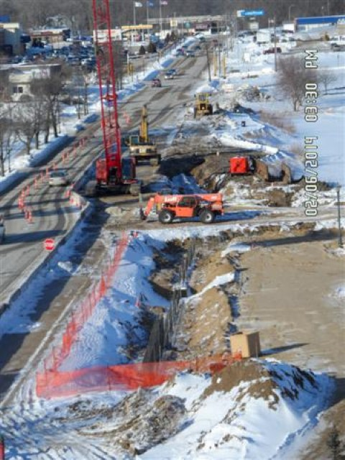

Slide 26
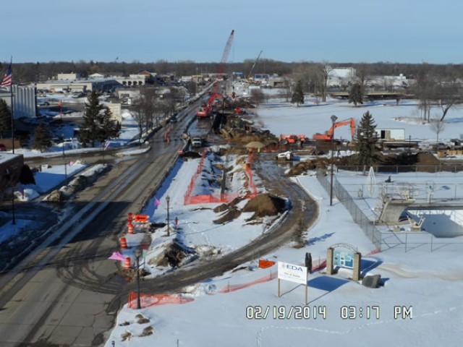

Slide 27
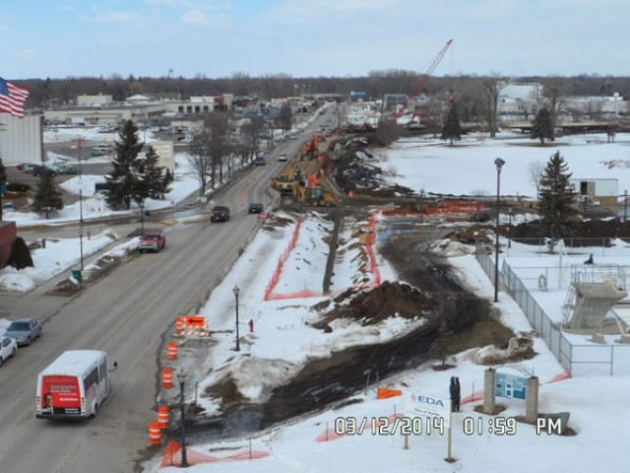

Slide 28
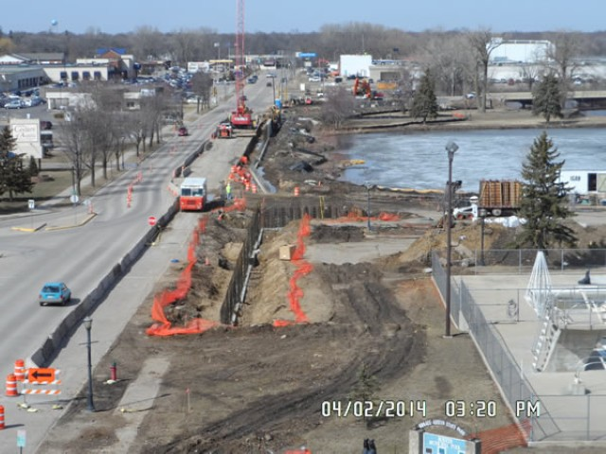

Slide 29
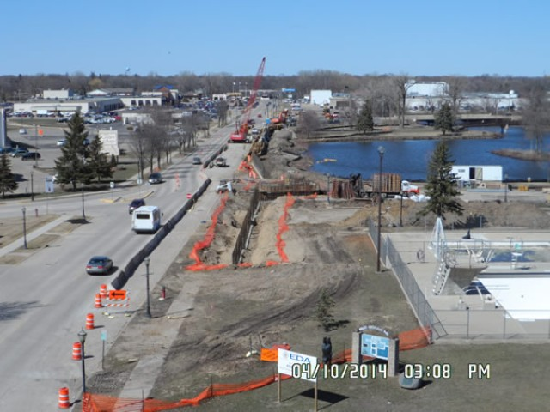

Slide 30
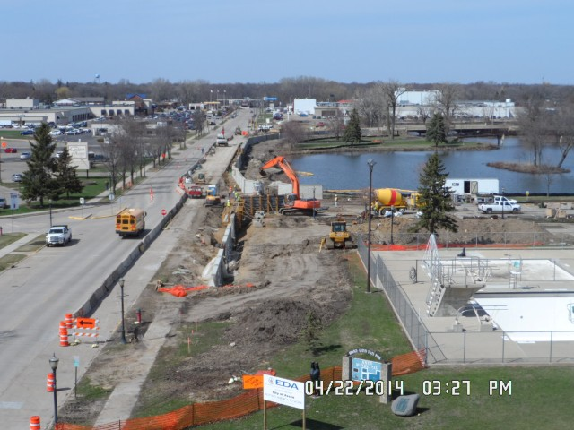

Slide 31
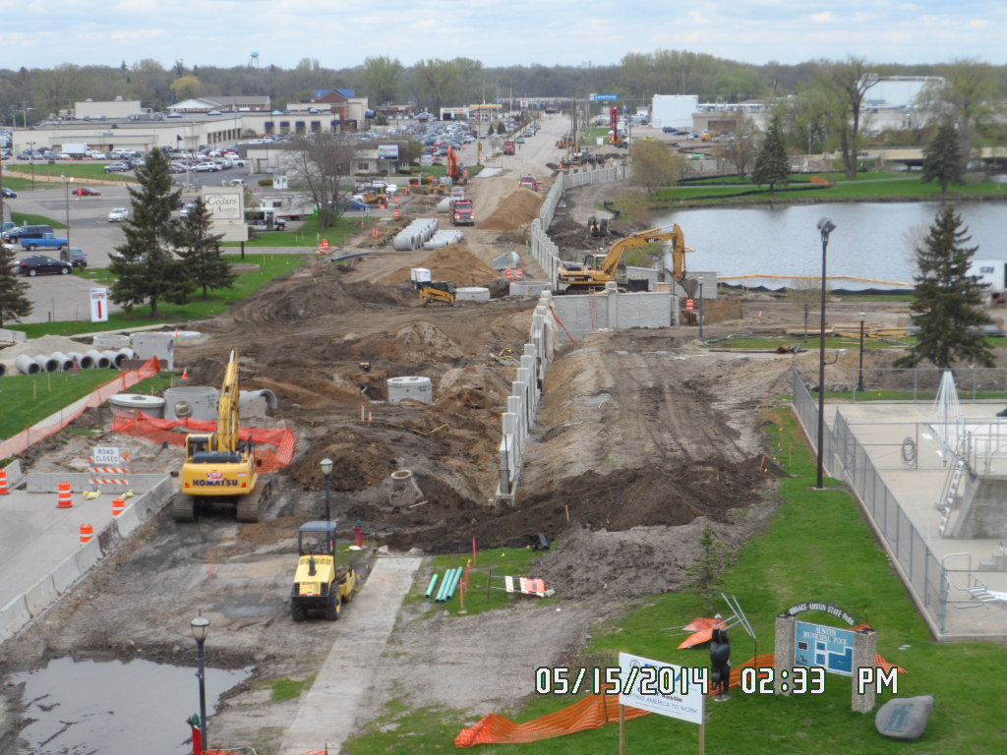

Slide 32
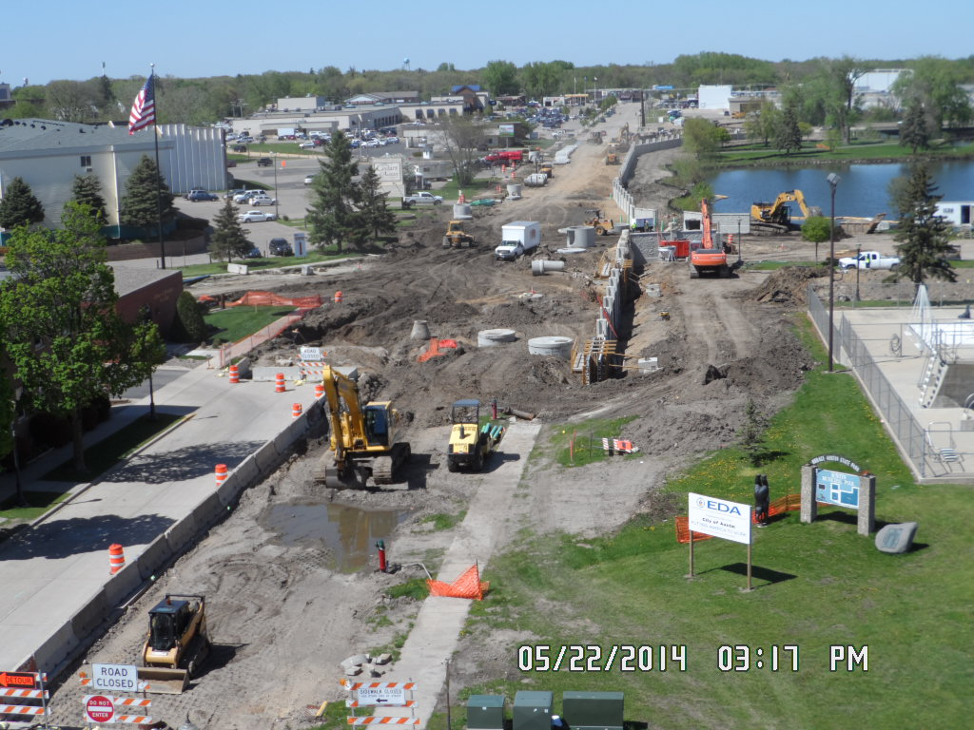

Slide 33
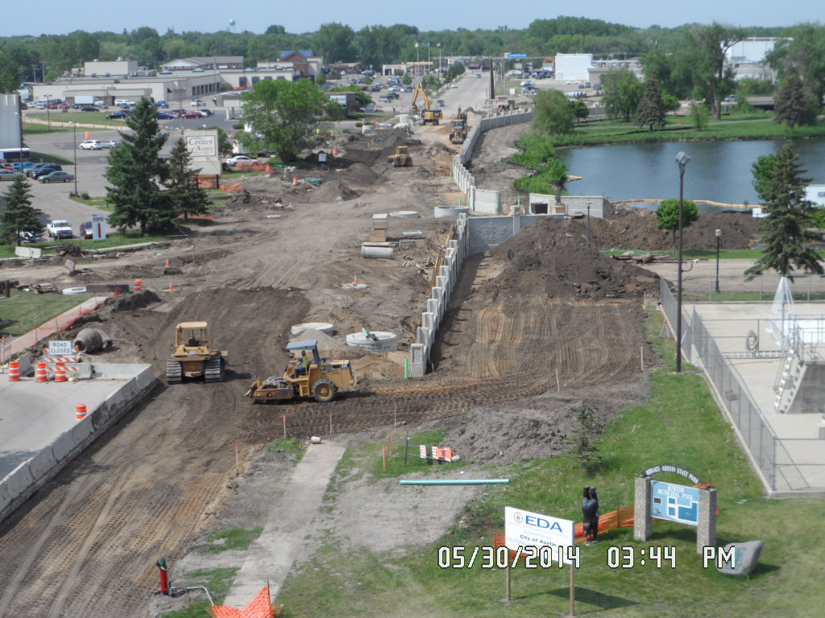

Slide 34
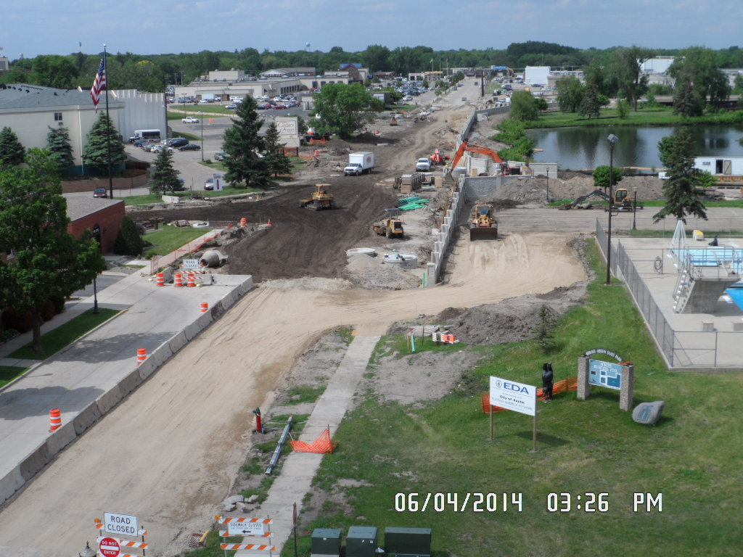

Slide 35
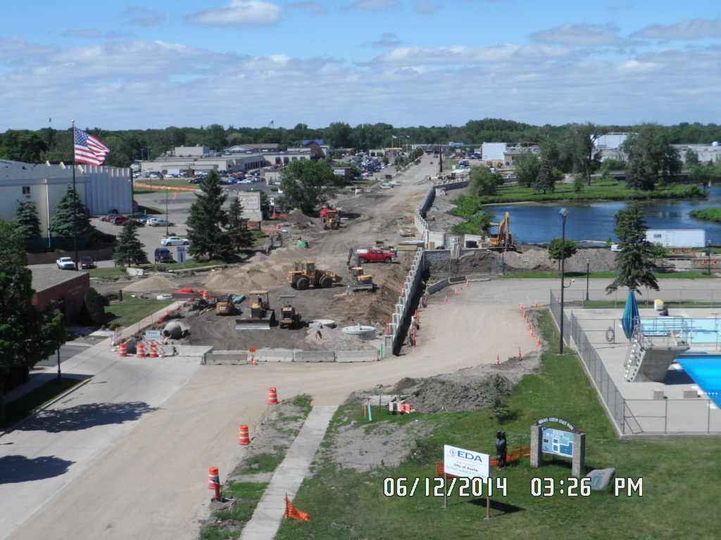

Slide 56
Floodplain Management Success Cape Girardeau, MO
Stan Polivick, P.E.,
Public Works Director
Notes:
Stan

Slide 57
Cape Girardeau, Mo
Founded late 1700’s
West bank of Mississippi River
Midway between St. Louis and Memphis
38,000 population
SEMO University, 2 hospitals, some light industry, regional retail center

Slide 58
Flooding Exposure
River Flooding
River front about 3 miles long
Significant River Floods
(10 ft above flood stage or higher)
1993, 1995, 1997, 2011, 2013, 2016, 2017

Slide 59
Riverfront Floodwall
Prior to the early 1960’s the riverfront in downtown Cape Girardeau was unprotected from flood waters.

Slide 60
Riverfront Floodwall
Early 1950’s - Two levee districts formed along the downtown riverfront.
Successfully engaged the Corps of Engineers for funding and construction of a floodwall and levee system.
Construction began 1958, completed 1964
Did not include areas upstream and downstream of downtown area.

Slide 61
Riverfront Floodwall
1.6 mile floodwall / levee protects downtown
North & South Riverfront still open
Notes:
Cape is fortunate that the two Levee Districts coordinated with the USACE. As part of a deal for Federal funding for necessary rehab work, the City took ownership of the system in 2008.

Slide 62
St. Louis, 100 miles
Memphis, 170 miles

Slide 63
River Flooding
August 1993 - severe flooding across the mid-west United States
Cape Girardeau … river reached record stage of 48.5 ft
Notes:
Flood Stage is 32 ft.

Slide 64
Red Star Neighborhood 1993
River Stage 48.5 ft
Notes:
Red Star neighborhood is just outside the levee system, and vulnerable to river flooding.

Slide 65
River Flooding
May 1995 - Crest 47.0 ft
May 2011 - Crest 46.3 ft
June 2013 - Crest 44.5 ft
January 2016 - Crest 48.9 ft, a new record
May 2017 - Crest 45.7 ft
Notes:
All significant events with widespread flooding.

Slide 66
Floodplain Management
After 1993 Flood residents showed no interest in the FEMA Buy Out Program.
After 1995 Flood there was a lot of interest!
Notes:
Repetitive Loss Program – remaining structures will predictably be put on the repetitive loss list.

Slide 67
Floodplain Management
Total of 114 homes bought out.
Two more in process now
About $2.7 million spent to date
Notes:
Repetitive Loss Program – remaining structures will predictably be put on the repetitive loss list.

Slide 68
Red Star 1993 & 2011 FEMA Buy Out Area

Slide 69
Smelterville Neighborhood
1993 Flood

Slide 70
Smelterville Neighborhood
2018

Slide 71
Floodplain Management
In addition to FEMA Buyout Program, City relocated two major facilities away from river
Wastewater Treatment Plant
Solid Waste Transfer Station

Slide 72
New Wastewater Plant away from river
New Wastewater Plant
beside river

Slide 73
Old Transfer Station near river
New Transfer Station
away from river

Slide 74
Summary
Lots of flood protection work done in Cape Girardeau since 1960.
Cape’s Floodplain Management Program has greatly reduced flood damage exposure
Downtown area is protected
FEMA Buy Out Program - 114 Properties Acquired

Slide 75
Summary
Four major floods since the 1995 buy outs.
2011, 2013, 2016, 2017.
Over 100 families have been spared the distress of four flood clean ups.
Millions of dollars of clean up and recovery costs have been avoided by our successful Floodplain Management practices.

Slide 76
Cape Girardeau Floodplain Management
Thank You
for Your
Attention!

Slide 77
UPPER MISSISSIPPI
RIVER CONFERENCE
October 25, 2018
Phil Risseeuw
Clerk/Treasurer
City of Darlington

Slide 78
Notes:
South Central WI
First organized in 1849 (from 1849 to 1869 was known as town of Centre)
880 acres
County seat; most agriculturally dependent county in the state
Dairy production and cheese processing basis for county’s economy
Gently rolling hills, with some steeper bluffs and deep valleys especially around the Pecatonica River
Landforms and topography are characteristics of the “driftless region” – unglaciated area
Lies in the Pecatonica River Basin located in the Middle Pecatonica River Watershed
Bekaa (or Pekka) means “slow”
Niba means water
Forming bekaaniba or “slow water”
As the “Pearl of the Pecatonica” the city has a rich history
Known as the “Pearl of the Pecatonica” because the river flows through he town, and people used to harvest the clams out of the river to make pearl button blanks.
Alfred T. Ringling established himself in Darlington at the age of 20 working as a harness maker in his own shop. He gave little shows for the students and citizens
2,443 population (2012)
Historic Main Street is listed on the National Register of Historic Places.
Main Street Community
Awarded the “coolest city” at the 2008 Building Economic Strength Together Conference

Slide 79
Flooding History
Floods that caused considerable damage include 1937, 1950, 1969, 1990, 1993, 2004, 2007, and 2008
Presidential Disaster Declarations in 1990, 1993, 2000, 2004 (Individual Assistance) and 2008 (Public Assistance)
Notes:
In 1974 the USCAE developed plans for a levee system in combination with channelizing the river. The project dies due to lack of support. There was no major flooding between 1969 and 1990 so complacency set in.
Major floods in 1990 and 1993. Due to the mitigation implemented downtown businesses have not been impacted in the more recent floods.
NWS has recorded 16 flooding events since 1950 that have resulted in $5.3 million in damages to property and $3.6 million to agriculture. Minor flooding occurred in 1994, 1998, 2009 and 2013.

Slide 80
Notes:
The second flood on record occurred in 1990 with significant damages to the City’s infrastructure, agriculture, agriculture, recreational trails as well as to residents and businesses.
All major highways into the City were closed.
The fire station was flooded and cut off from half the city and several surrounding townships. (The fire station was in the floodplain and during flooding the equipment had to be moved and split and placed on either side of the river.)
Several fuel tanks located along the river were damaged.
Wastewater treatment plant and lift station were damaged.
Storm sewers and sanitary sewers sustained damage from sediment and gravel.
In the downtown business district 30 businesses were damaged some with 4 feet of water over the first floors.
Outside of the downtown area homes were inundated as flood waters rose 7 feet above flood stage.
City officials, citizens, and business owners decided they cold no longer sit by and let nature decide the future of their community. After the 1990 flood, the city focused on mitigation alternatives. Construction of dams and levees were discussed again, however, due to negative impact on the environment, other non-traditional flood damage reduction alternatives such as relocation, floodproofing and elevation of structures were put forth.

Slide 81
Acquisition/Demo
Notes:
Complicated and challenging. Three sites along the river were found to be contaminated. The City completed remediation at nearly $1 million, while the mitigation program provided the funds for the actual acquisition and demolition. To make this work compromises had to be made on all sides; local, state and federal.
The city completed the remediation and applied to the PECFA fund. Remediation had to be completed before the structures could be acquired and demolished with federal funds. In some cases, the remediation could not be completed until the structure was removed. The City acquired several properties, and were then reimbursed through the grant programs after remediation. (Not a normal practice and took a lot of negotiations with the state and federal agencies. Not so flexible today.)

Slide 82
Relocation
Developed 33 acre business park
Notes:
Since businesses were being displaced, the city needed to develop a business park for the businesses to relocate to. The City purchased 33 acres on higher ground. EDA provided funding for the infrastructure at the new business park.
15 commercial properties were acquired and demolished since 1994.

Slide 83
Relocation
Notes:
The City of Darlington applied for a FFY02 FMA grant and acquired/demolished the fire station and relocated outside of the floodplain. ($152,167 100%; $114,125 federal share, $38,042 local)
The wastewater treatment plant has also been relocated out of the floodplain. All major utilities such as gas and electricity have been raised.

Slide 84
Recreation

Slide 85
Solution
Notes:
Existing windows and doors, part of the exterior façade, to remain intact or restored to historic detail. This created a dilemma of how to maintain the historic façade and entrance to the building well below the flood level for historic purposes and raise the first floor several feet higher.
The solution was to construct a vestibule or foyer just inside the front door at street level with an 8-inch thick inside floodwall and floodshield separating the vestibule or foyer form the raised first floor with stairs leading to it. The vestibule was constructed with materials that would not sustain flood damage (ceramic tile, brick, cements, etc.) The vestibule would be allowed to flood. Since constructed with water proof type materials, the vestibule could be easily washed/hosed after a flood event.
A flood shield would be installed at the first floor at the top of the stairs and connected with the interior floodwall at FPE. (Cast aluminum plate with pressure locking handles that sealed the plate tight against rubber gaskets.)
The height of the barrier (flood wall) would be at the FPE – height of perimeter wall.
Drain tile was installed in the subfloor as s secondary measure (in the event of any seepage.) The drain led to a common sump pump for a group of buildings.
Electrical, utilities, and mechanics were all raised to the FPE.
Due to the agreement, the structure became a “conforming” structure for future zoning considerations.

Slide 86
BEFORE
AFTER
Notes:
First building to be completed (Gil Barnard – Train in the station . . . .)

Slide 87
Flood? What Flood?

Slide 88
Local Expert Panel:
David Sturch
Cedar Falls, IA
Cindy Cregmiles
Jersey County, IL
Holly Wallace
Austin, MN
Stan Polivick
Cape Girardeau, MO
Phil Risseeuw
Darlington, WI
Moderator: Paul Osman, Illinois DNR

